Slide 1


WG 3 - MLOps best practices
Gabriela Aznar Siguan, Frank Guibert, Marek Jakob
E. Briola, L. Trani, N. Tarin Burriel, I. Schicker, H. Theissen, B. Butler, J. Castro, M. Cattaneo, H. de Laroussilhe, H. Kivril, B. Hargitai, O. Hinojo, K. Krus, S. Montazeri, D. Nerini, Y. Radev, M. Stoicescu, F. Teichert, H. Vandenbroucke-Menu, M. van Ginderachter, R. Derks, M. Zacharuk, S. Olah, ... and all WG 3 participants
E-AI summer workshop 10.07.2025

Slide 2
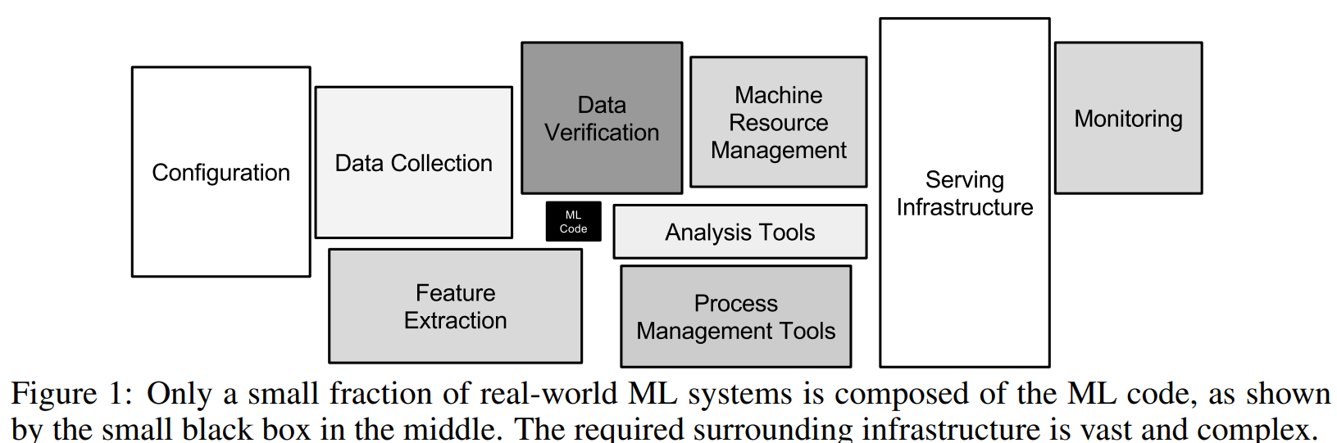
What is MLOps?
MLOps combines machine learning, software engineering, and DevOps principles to streamline and operationalize ML systems.
The concept first emerged in 2015 in the paper “Hidden Technical Debt in Machine Learning Systems, D. Scully et al”.

Slide 3




What do you need to implement MLOps?
Culture (team structure, collaboration, …)
Governance (best practices)
Processes (standardize lifecycle)
Technologies (tools, platforms)
Notes:
Culture Covers team structure, ownership, communication, and mindset toward collaboration and experimentation.
Process Standardized ML lifecycle management: development, validation, CI/CD, deployment, retraining, and rollback procedures.
Technology All tools and platforms across data pipelines, modeling, orchestration, monitoring, and infrastructure.
Governance Encompasses best practices, compliance, documentation, testing, explainability, fairness, and reproducibility.

Slide 4
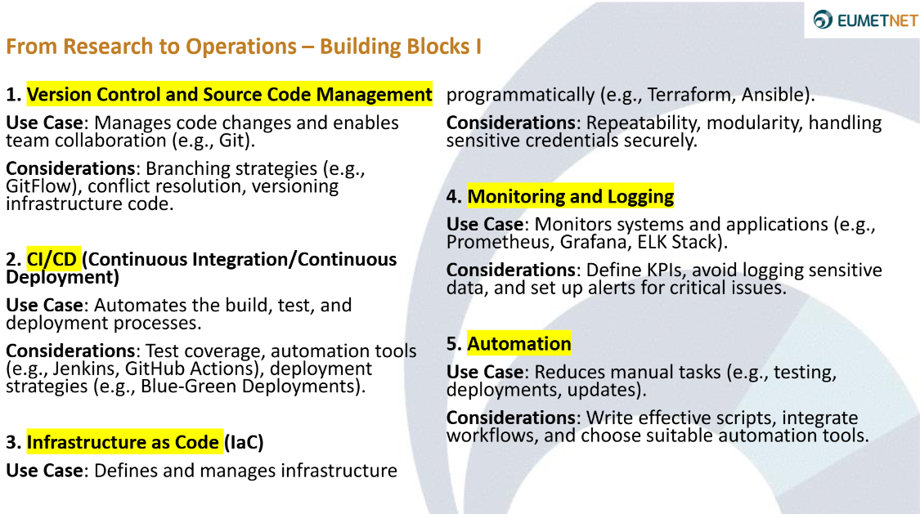
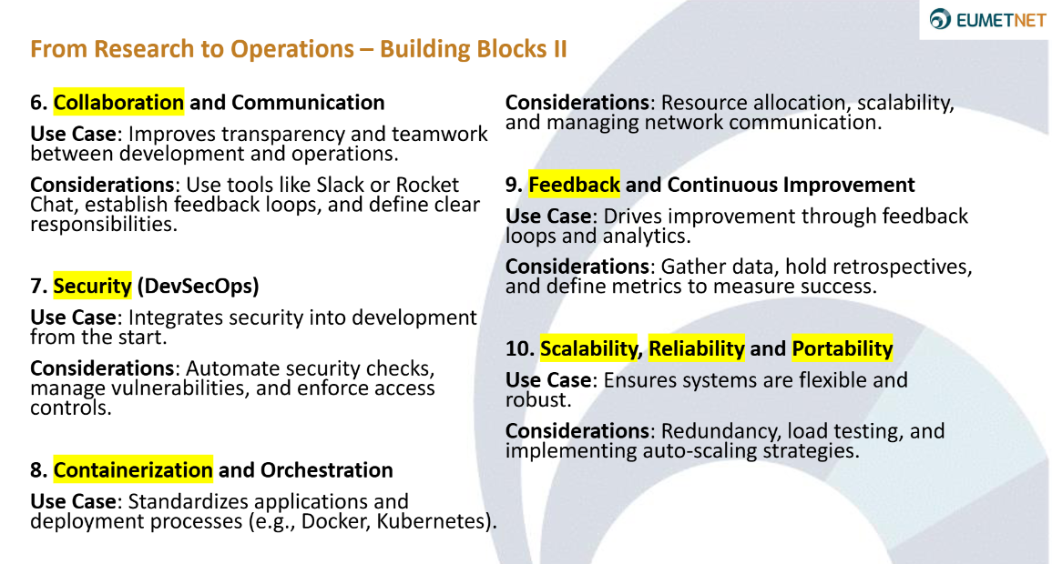
MLOps Building blocks
E-AI Tutorial on MLOps

Slide 5
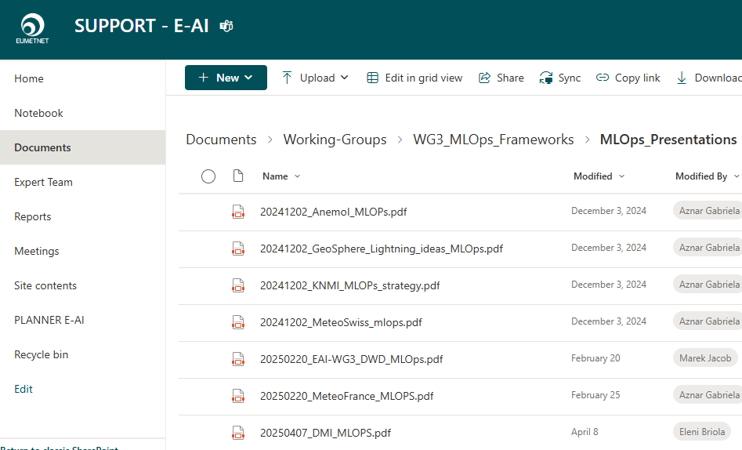
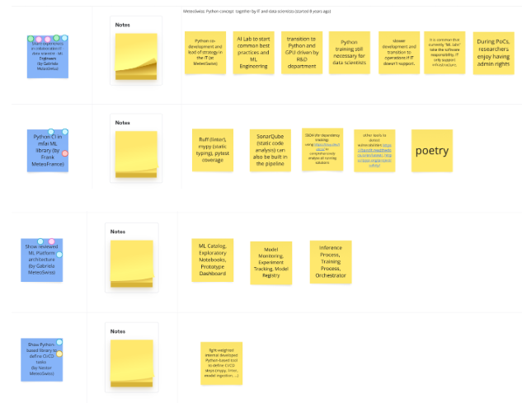
What have we been doing in WG3 wrt MLOps?
Presentations of MLOps experiences and strategies of various organisations.
Open discussions following the Lean Coffee approach.
MLflow workshop with ECMWF ML Pilot.
Consolidation: living documents MLflow best practices (currently in E-AI SharePoint).

Slide 6
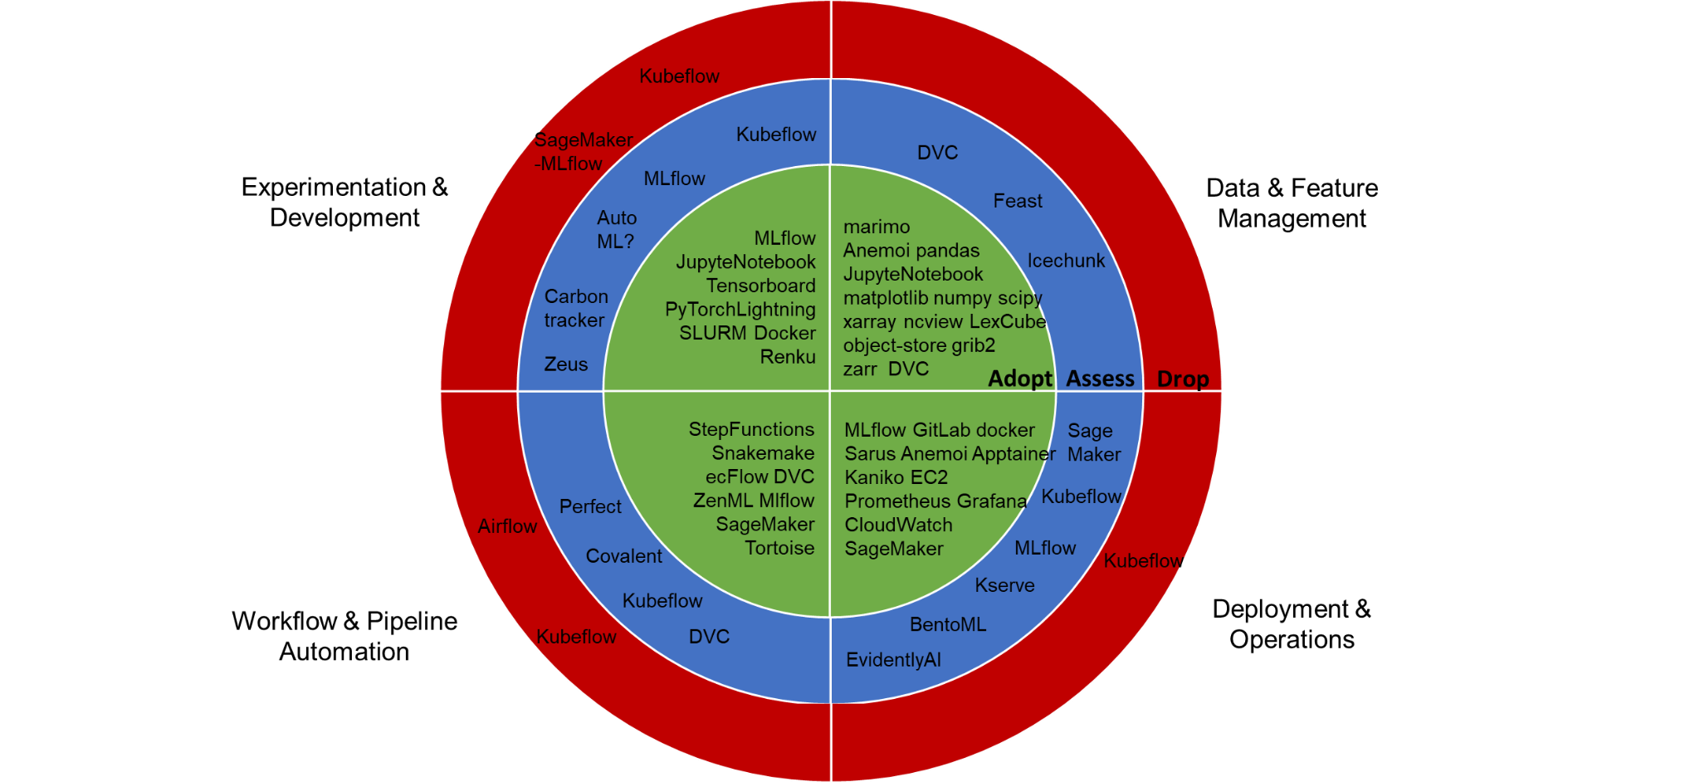
State of Technology Trials and Adoption
Conclusion:
Exchange, we have a lot of experience with a wide range of technologies.
There's no magic formula – what works for some doesn't work for others (e.g. Kubeflow, SageMaker).
Some solutions are starting to be used by the whole community (e.g. MLflow).

Slide 7
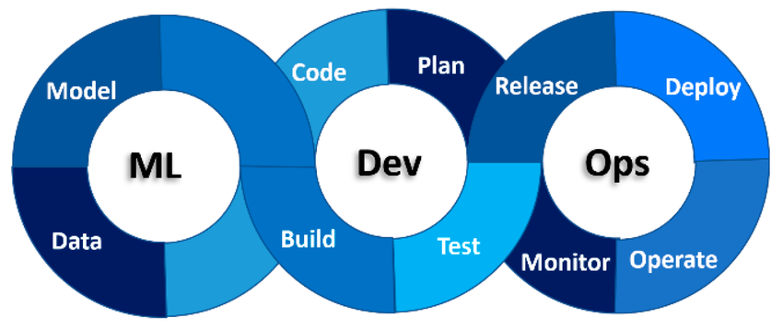
How the Technologies Are Being Applied
Subramanya, et al. , 2022

Slide 8
How the Technologies Are Being Applied - ML -

Slide 9


ML - Data Ensure reproducibility and lineage of datasets
Transform: - Apply using reproducible, version-controlled code - Preserve and propagate metadata (up to inference)
.csv
.npy
.npz
.txt
.parquet
- Zarr format for large datasets. Optimize dataset for specific ML task needs (chunking, variables).
- Versioning using tools like Data Version Control (DVC).
Preserve original data in its native format.
Resources in E-AI: E-AI Data Inventory (WG 1), Anemoi Datasets Catalogue

Slide 10
ML - Model Train, evaluate and register ML models
Model architectures library
Log env, config, input, checkpoints, model, git hash, metrics, plots, …
Register selected models and assign versions.
Experiment Tracking
Model Registry
Promote to staging and production.
Experiment
Design experiments by defining clear hypothesis and expected performance.
… using tools like MLflow
Resources in E-AI: Neural Network Architectures in mfai and Anemoi, Anemoi’s Experiment tracking and Model catalogue.

Slide 11


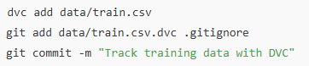
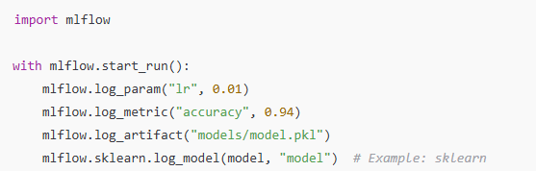
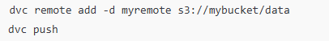
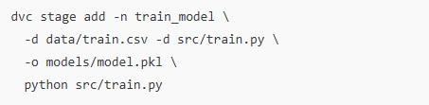
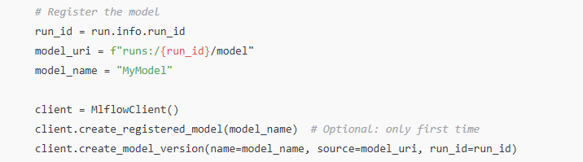
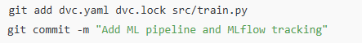
Data Version Control and MLflow
DVC for Data & Pipelines
Use DVC to:
Track datasets and model artifacts (e.g., .pkl, .pt, .h5).
Define a reproducible pipeline with dvc.yaml.
Push/pull large files using remote storage (e.g., S3, GCS).
2. MLflow for Experiments & Logging
Use MLflow to:
Log metrics, parameters, and artifacts during training.
Track multiple runs and compare them.
Serve and deploy models via MLflow’s model registry.
DVC lets you capture the versions of your data in Git commits, while storing them on-premises or in cloud storage.
MLflow provides a lightweight framework to track experiments by logging parameters, metrics, artifacts, and models.
DVC + MLflow = ❤️
Component | Tool | Purpose
Data | DVC | Versioned storage + remote sync
Experiments | MLflow | Param/metric logging, comparisons
Models | MLflow | Model tracking
Pipelines | DVC | Reproducible steps and dependencies
DVC introduces a build system to define, execute and track data pipelines.
MLflow manages the full lifecycle of ML models through a centralized model registry.
Notes:
You can use this command instead of git add on files or directories that are too large to be tracked with Git: usually input datasets, models, some intermediate results, etc. It tells Git to ignore the directory and puts it into the cache (while keeping a file link to it in the workspace, so you can continue working the same way as before). This is achieved by creating a tiny, human-readable .dvc file that serves as a pointer to the cache.

Slide 12
How the Technologies Are Being Applied - DEV -

Slide 13
DEV - Plan Define objectives, data strategy, evaluation protocols and collaboration frameworks
Council (Architecture, …)
Govern: Organisational alignment
Key considerations:
Objectives
Requirements
Evaluation
Data Strategy
Traceability
Risks
Lifecycle
Development
Organization
Community of Practice (Python, ML, …)
Learn: Promote best practices
Enabler Team (MLOps, …)
Support: Libraries, templates, tooling
Solution Team (Problem domain)
Build & Maintain: Collaboration Setup (Kanban, SCRUM)

Slide 14
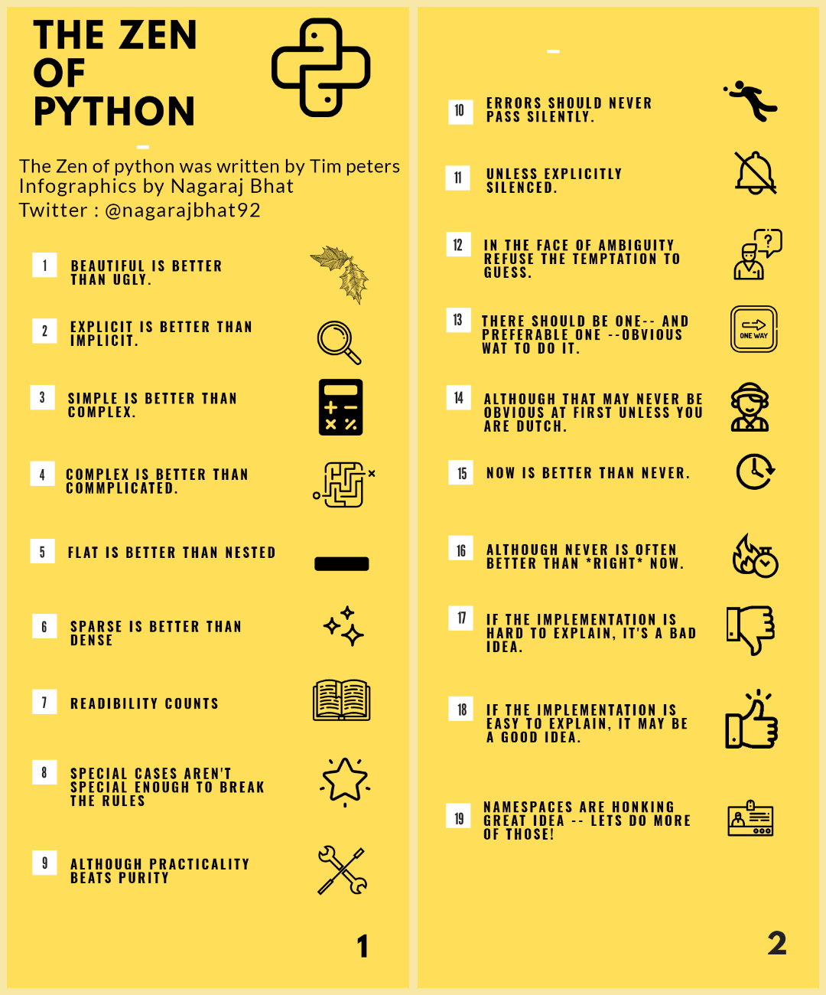
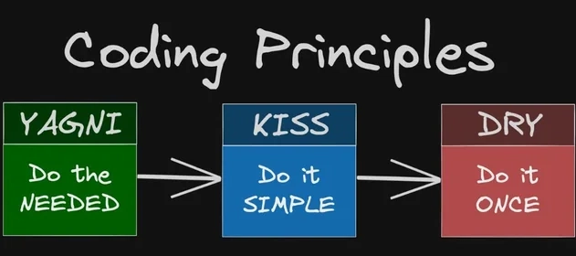
DEV - Code Develop modular, testable and version-controlled ML logic and pipelines
Key considerations:
Principles
Standards
Configuration
Secrets
Version
Documentation
Visualization
Collaboration
Pipelines
The Zen of Python
TDD (Test-Driven Development)
YAGNI (You Aren’t Gonna Need It)
DRY (Don’t Repeat Yourself)
KISS (Keep It Simple, Stupid)
Notes:
Zen of python reflects the main ideas backing the authors of Python, how their language should be used for and what the developers should deeply understand in order to fully embrace the “pythonist” principles.

Slide 15
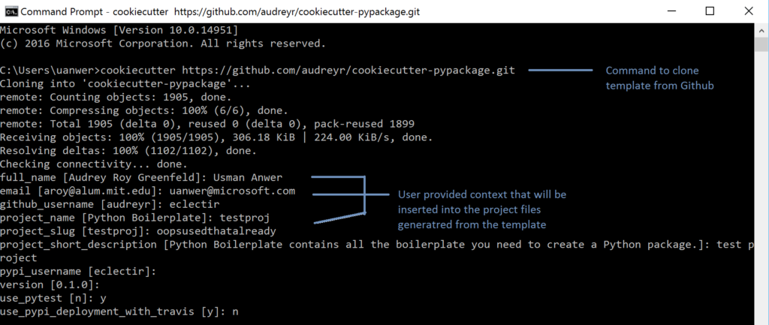
DEV - Code Develop modular, testable and version-controlled ML logic and pipelines
Key considerations:
Principles
Standards
Configuration
Secrets
Version
Documentation
Visualization
Collaboration
Pipelines
Adopt and enhance organizational ML blueprints, libraries and coding conventions.
Use templating tools to automate and enforce shared standards across teams.

Slide 16

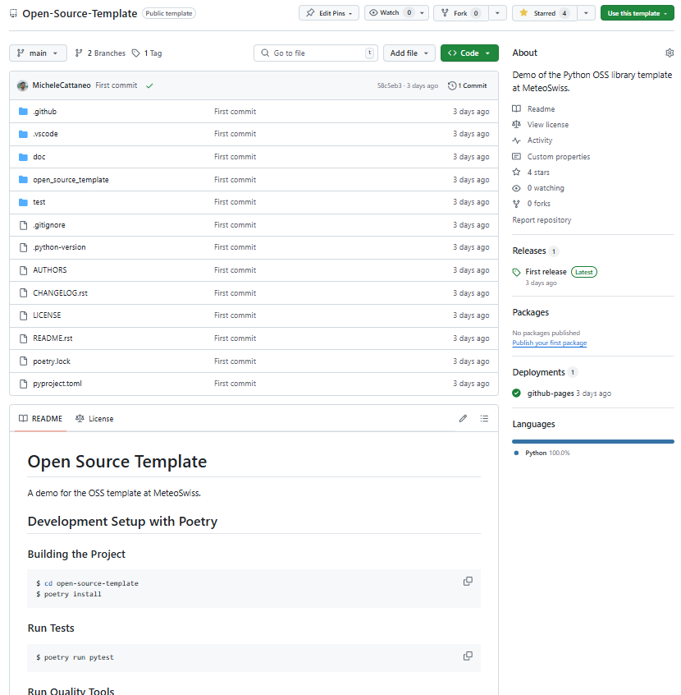
Open-Source Python Application Template by MeteoSwiss
https://github.com/MeteoSwiss/Open-Source-Template
✅ CI/CD with GitHub Actions
CI: Runs tests on every push and pull request to the main
CD: On version-tagged commits, automatically:
Publishes to TestPyPI, then PyPI
Builds and deploys documentation to GitHub Pages
📄 Pre-configured Markdown Templates
Issue templates for bug reports & feature requests
Pull request templates with guided checklists
🔒 Versioning Consistency Check
Release tag must match the version in pyproject.toml
generated with cookiecutter
M. Cattaneo, H. de Laroussilhe, L. Knirsch

Slide 17
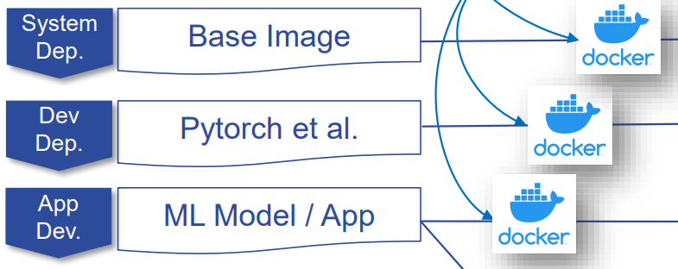
DEV - Build Prepare the system for execution and deployment
Key considerations:
Dependencies
Containers
Layering
Container Registry
Linting
Security
CI/CD
Caching
Model Integration
Layered container images with shared base
Speeds up builds via caching, improves consistency across projects and simplifies updates and security patching.

Slide 18
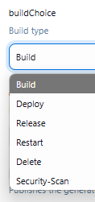
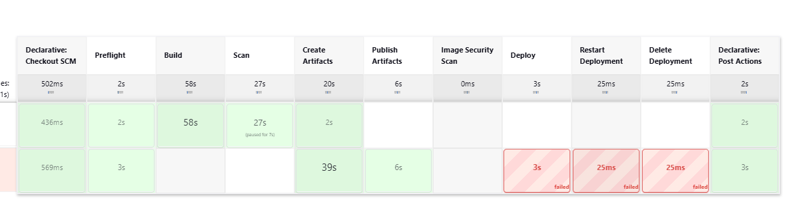
DEV - Build Prepare the system for execution and deployment
Key considerations:
Dependencies
Containers
Layering
Container Registry
Linting
Security
CI/CD
Caching
Model Integration
Automate builds, tests, linting, static analysis, security scans, and deployments using CI/CD tools (GitHub Actions, GitLab CI).
Contribute to portable, reusable scripts that encapsulate the CI/CD workflows and are decoupled from specific projects.

Slide 19

DEV - Test Ensure your ML code, data and models behave as expected
Key considerations:
Unit & Integration Tests
Data Validation
Configuration Reproducibility
Model Evaluation
CI Automation
Benchmark models against performance thresholds and baselines across regimes, geographies or forecast lead times.
Ensure model artifacts serialize and reload consistently for deployment.
Open Neural Network Exchange (ONNX) provides a standard way to represent models.
Significantly reduce the image size and startup time, which is especially valuable in cloud, serverless, or edge deployments.

Slide 20
How the Technologies Are Being Applied - OPS -

Slide 21
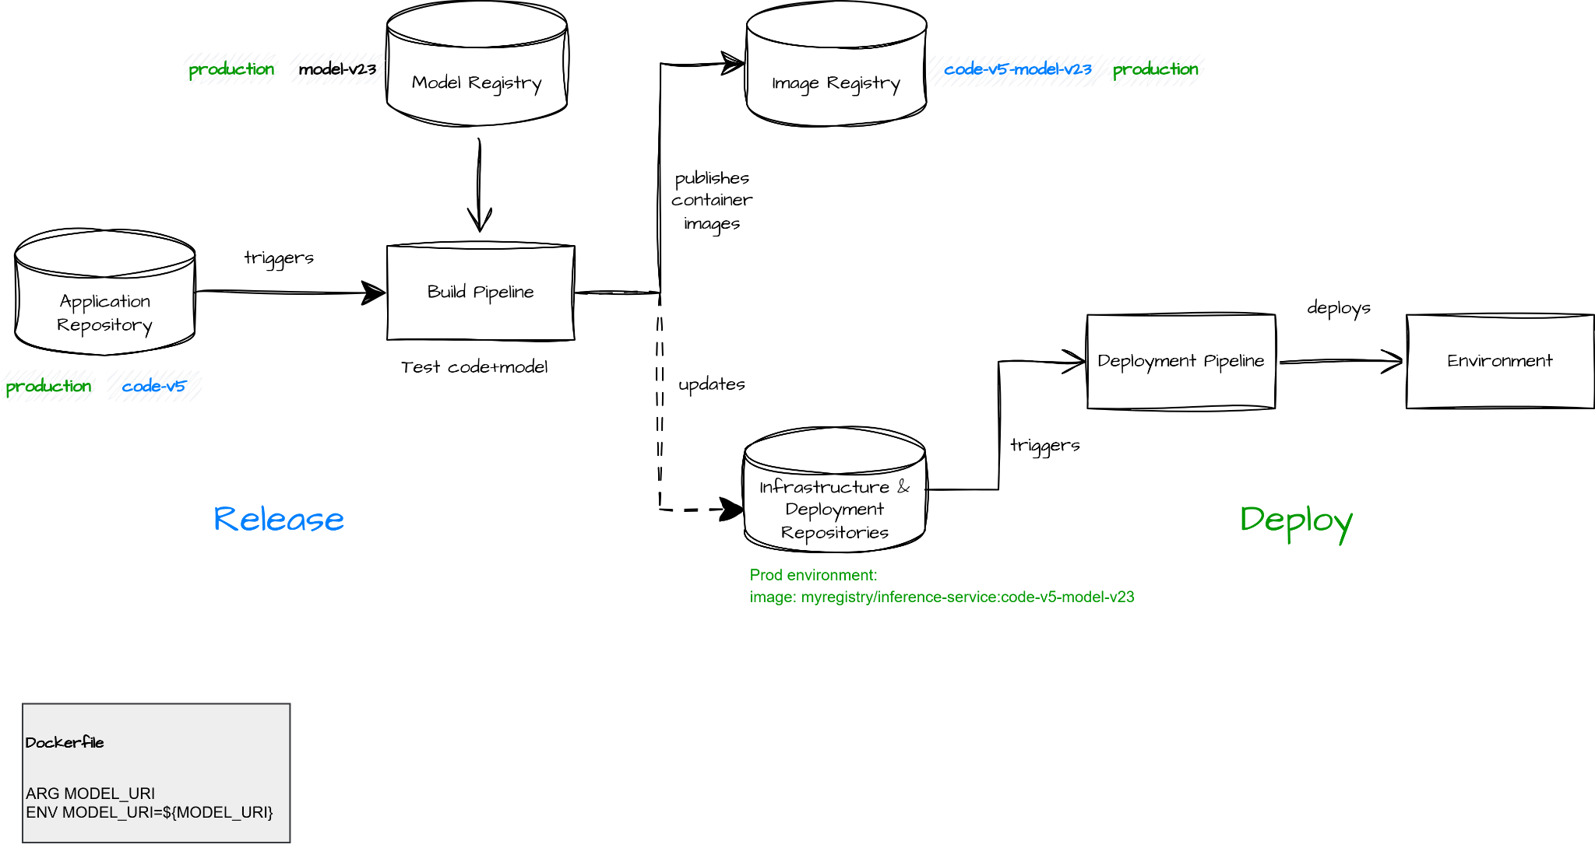

OPS - Release & Deploy Release: Promote tested models and pipelines to production-readiness
Deploy: Serve models reliably across deployment stages
GitOps: Git as the single source of truth automating deployments
Notes:
ARG MODEL_URI
ENV MODEL_URI=${MODEL_URI}

Slide 22
OPS - Operate & Monitor Operate: Run and manage the production system
Monitor: Track model performance and behavior over time
Monitoring is critical in ML to detect issues like data drift, prediction skew, and performance degradation — but finding the right tool is challenging:
Need for customizable visualizations — especially for geospatial data.
Must handle high data volumes with low latency.
Preference for low-maintenance or easily operable solutions.
Assessing the trade-offs and benefits of a centralized solution across teams or domains.
The feedback loop — i.e., the delay between model predictions and receiving ground truth — complicates real-time performance monitoring and model retraining decisions

Slide 23
Proposed goals for WG-3
Interoperability: agree on interface contracts between Python components and HTTP APIs.
Objective: being able to exchange neural network architectures, loss functions, metrics transparently between different projects of different met offices.
Agree on development standards (type checking, linting, complexity, …) and supply templates and/or recipes to disseminate and enforce them.
Produce a first version best practices document on operating ML-based products (e.g. forecasts, post processing) and services (e.g. chatbots)

